Slide 1
Roots Africa Data Dashboard Final Presentation
Bruck Getnet, Scott Chen, Demetrios Tzamaras, Rishabh Banga, Ildreed Mbami, Yosef Tsigie

Slide 2






Team Members
Project Manager
Rishabh Banga
Research Lead
Bruck Getnet
UX Designer
Scott Chen
Technical Lead
Demetri Tzamaras
Data Analyst
Yosef Tsigie
Client Lead
Ildreed Mbami

Slide 3
Our Journey
Who We Are: Information Science students specializing in data visualization and dashboard development
Client: Roots Africa, an NGO working to end hunger and poverty through agricultural education and entrepreneurship development in Liberia and Uganda
Mission: Create a comprehensive data monitoring dashboard to help Roots Africa track and showcase their community transformation efforts
Project Timeline: January - May 2025
Rish

Slide 4

Sowing Seeds of Change
About Roots Africa
Founded by Cedric Nwafor, who immigrated from Cameroon to the US
Mission: "Africa doesn't need charity, it needs changemakers"
Trained 648 changemakers who have trained 11,349 farmers
45% of change makers continue training without direct support
Focus on resilient agriculture and entrepreneurship development
Bruck

Slide 5
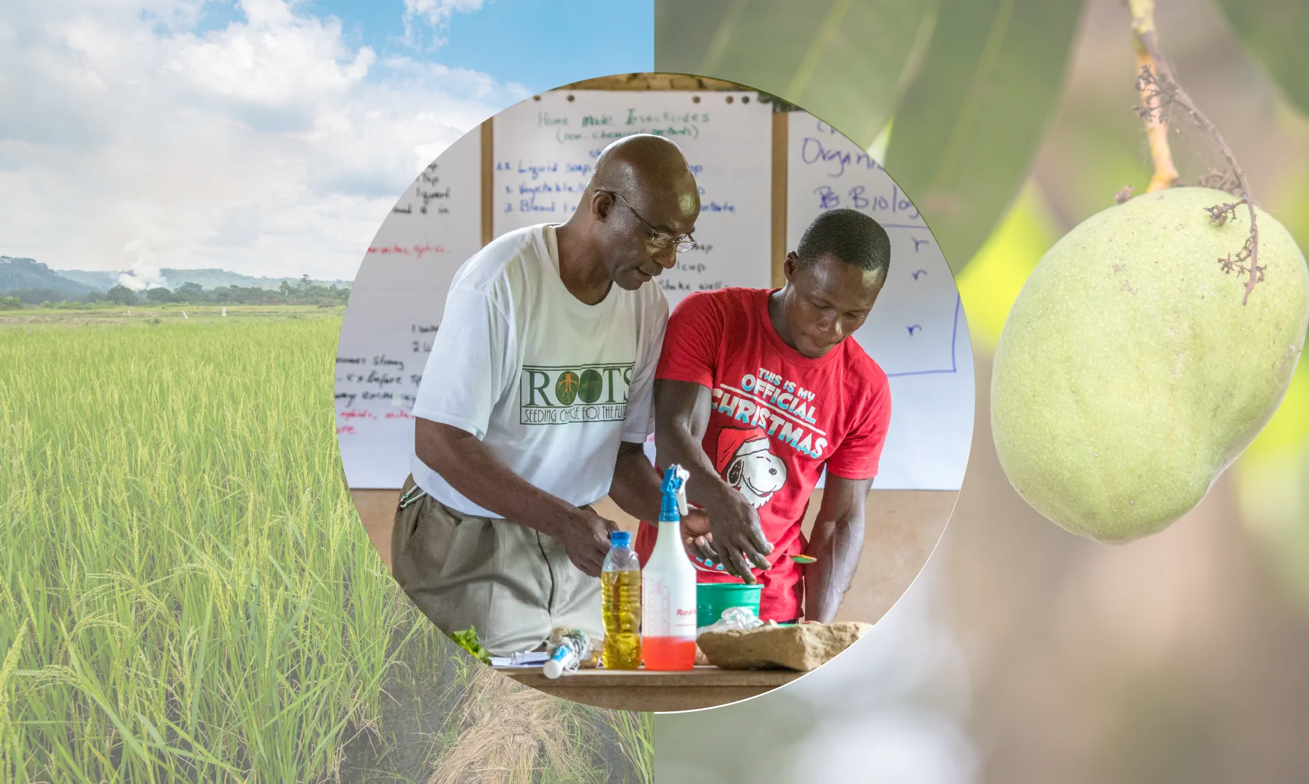
Approach & Impact
Community-led agricultural initiatives emphasizing resource optimization
Global mentor connections with 175 instructors worldwide
83% of changemakers maintain connections with mentors
7 in 10 households increased income after training
30 pods have created consulting businesses focused on training other farmers
Bruck

Slide 6
The Problem
Business Challenge
Despite training over 11,000 farmers across Liberia and Uganda, Roots Africa faces significant challenges in tracking, measuring, and communicating their impact
No centralized data visualization system for monitoring community transformation
Difficulty making data-informed decisions about resource allocation
Ildreed

Slide 7
Information Management Issues
Field data collection challenges in remote areas with limited connectivity
Need for unique identifiers to track farmers and communities over time
Lack of standardized metrics for measuring community maturity and readiness
Limited capacity to analyze collected data and generate actionable insights
Ildreed

Slide 8
The Solution
Proposed Solution
Comprehensive data dashboard integrating multiple data sources
Kobo Collect implementation for standardized field data collection
Interactive dashboard with geospatial visualization capabilities
Ildreed

Slide 9
Data Collection
Kobo Collect Surveys
Community Resource Mapping: Infrastructure, available services, natural resources, financial services
Community Readiness Assessment: Leadership structures, farmer groups, farming practices, market access
Community Maturity Assessment: Community-led initiative history, youth/women involvement, problem-solving approach
Individual Household Surveys: Income sources, farming techniques, food security, training interests
Demetri

Slide 10
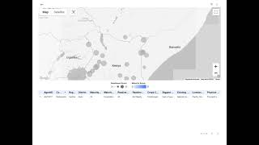
The Dashboard
Demetri

Slide 11
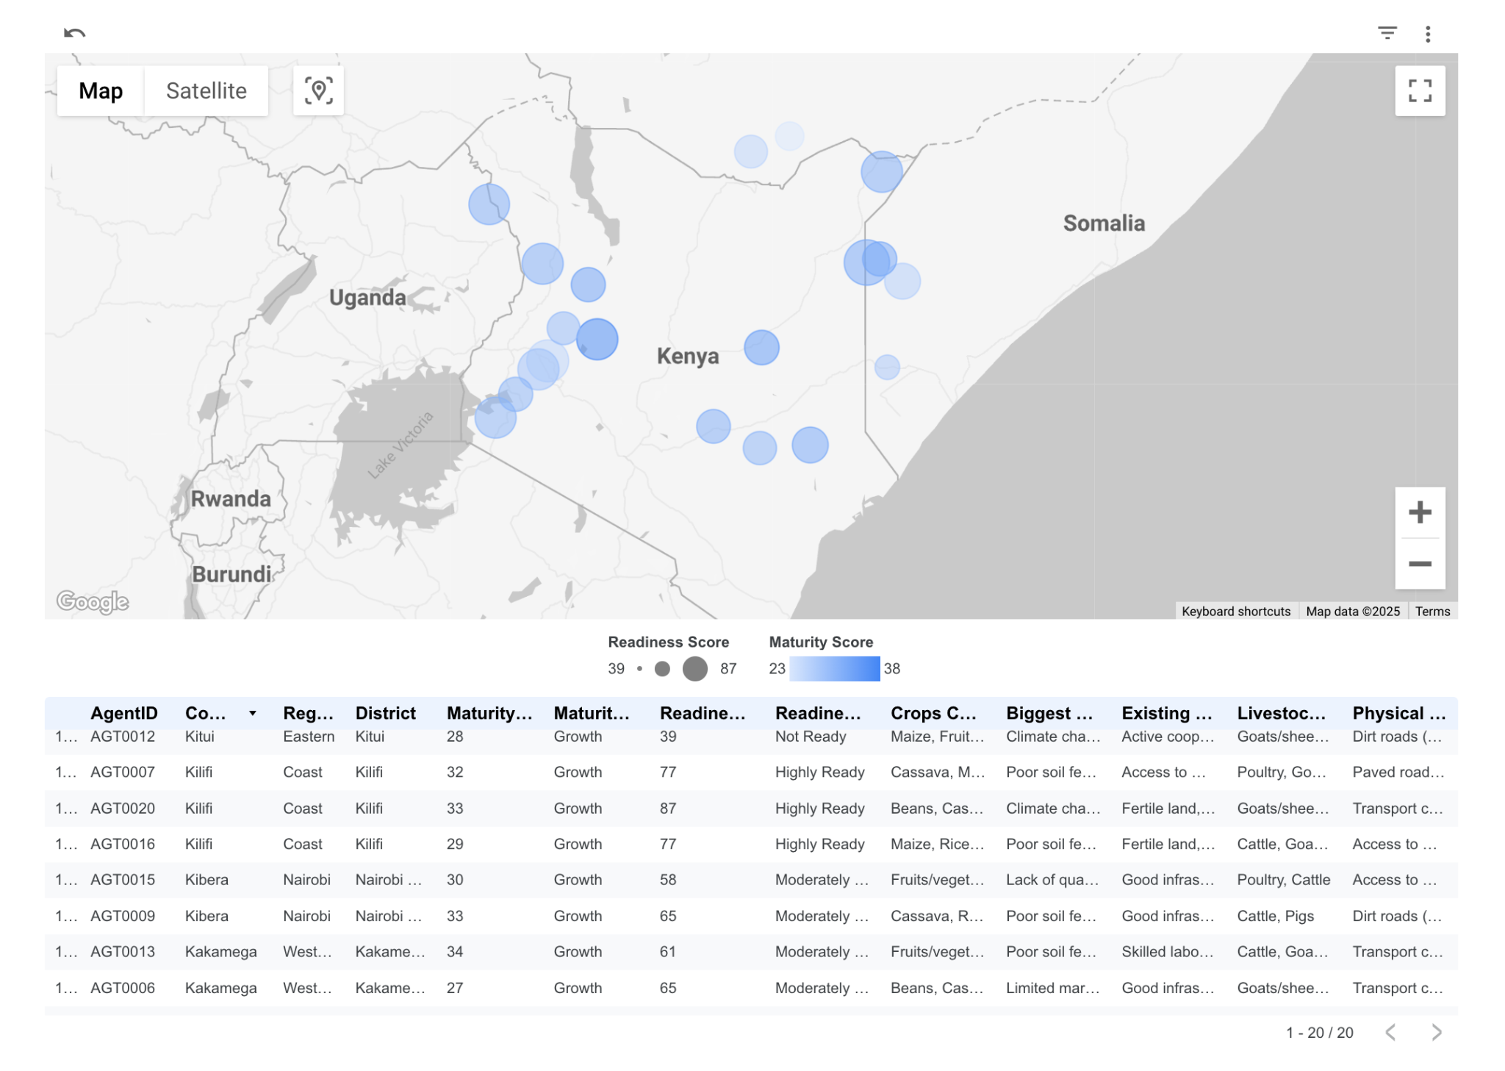
The Dashboard
Key Dashboard Features
Geospatial mapping of communities
Community maturity and readiness score visualization
Resource mapping integration
Demetri

Slide 12
Decision Making Tools
Community comparison visualization
Resource gap identification
Training impact measurement
Data export capabilities for reporting
Filtering by region, maturity stage, and crops
Rish

Slide 13
Analyzing the Field
Key Findings from Data
Communities with stronger leadership structures showed faster progress
Market access remains a significant barrier in most regions
Communities with youth involvement showed higher innovation rates
Common resource gaps: storage facilities, transportation infrastructure
Most communities fall in Growth (26-35) stage, indicating positive momentum
Rish

Slide 14
Challenges
Project Challenges
Technical Complexity: Integration between data collection and visualization
Connectivity Issues: Limited internet in rural areas of Liberia and Uganda
Data Quality: Ensuring consistent entry across field agents
Resource Constraints: Client has limited technical staff
Implementation Timeline: Balancing comprehensive features with project deadline
Scott
Notes:
Throughout the project, we encountered several significant challenges. One of the biggest was the technical complexity of linking field data collection with real-time dashboard visualization. Many of the areas where Roots Africa operates have limited internet access, which made syncing data difficult. We also had to address inconsistencies in how different field agents entered data, which affected quality and reliability. In addition, the client had a small technical team, so we had to ensure the final system was easy to use and maintain. Finally, we had to carefully manage our time to deliver all planned features before the project deadline.

Slide 15
How we overcame them?
Prioritized offline functionality in Kobo Collect
Created comprehensive user guides with visual tutorials
Developed data validation procedures to ensure quality
Simplified dashboard interface for non-technical users
Phased implementation approach focusing on core requirements first
Scott
Notes:
To overcome these issues, we focused on practical solutions. We enabled offline functionality in Kobo Collect so field agents could continue collecting data without needing internet access. We also created thorough user guides with visual step-by-step tutorials to help onboard future users. To improve the consistency of incoming data, we implemented validation procedures that reduced errors at the point of entry. The dashboard interface was simplified to make it more accessible for non-technical users. We also took a phased development approach, delivering the most critical features first to ensure we stayed on track.

Slide 16
Results
Delivered Solutions
Data Collection System: Fully configured Kobo Collect with four survey types (Community Resource Mapping, Community Readiness, Household Surveys, Maturity Assessment)
Interactive Dashboard: Geospatial visualization showing community locations, maturity scores, readiness levels, and key agricultural data
User Documentation: Comprehensive guide for maintaining data collection and dashboard systems
Scott
Notes:
By the end of the project, we were able to deliver a complete data system tailored to Roots Africa’s needs. This included a fully set up Kobo Collect environment with four distinct survey types: Community Resource Mapping, Community Readiness, Household Surveys, and Community Maturity Assessment. We also developed an interactive dashboard featuring geospatial visualizations, maturity scores, readiness tracking, and key agricultural data. To ensure long-term usability, we provided a comprehensive guide for maintaining both the data collection and dashboard systems. These tools will allow Roots Africa to better understand their impact and support more data-informed decision-making.

Slide 17
Impacts of Data DB
Easily identifies communities most ready for RA transformation
Optimizes resource allocation to meet community needs
Offers better reporting to donors & stakeholders (Export Feature)
Ability to track community progress long-term
"This isn't just a technical solution, it's a change in how Roots Africa understands their impact"
Yosef

Slide 18
Next Steps
Suggest field agents complete data collection for all communities (Dummy data)
Ensure a proper handoff by developing a training document for future dashboard administrators
Continue exploring advanced analytical capabilities to discover further success factors
Yosef

Slide 19
Long-Term Vision
Advise RA to create a community-facing dashboard for local leaders
Inform RA to develop a mobile app for increased accessibility
"The long-term vision is for communities themselves to use data to drive their own transformation"
Yosef

Slide 20
Thanks!
Do you have any questions?

